Slide 1
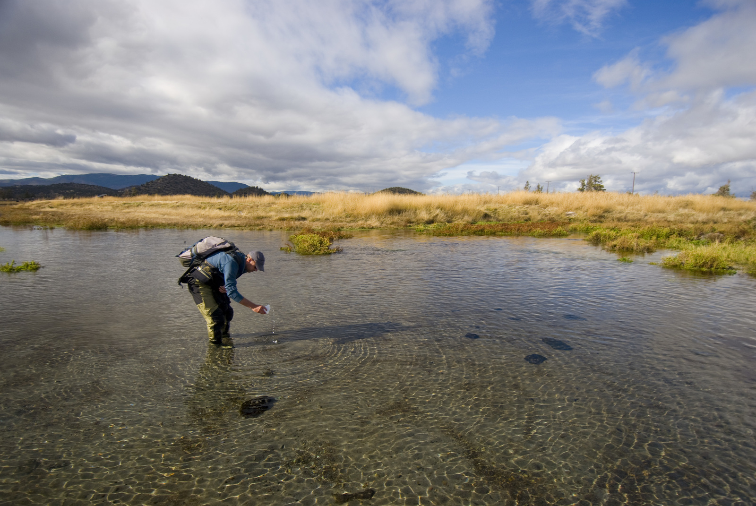
Mitigating Climate Change Impacts:
Opportunities for Land Trusts under the
Sustainable Groundwater Management Act
2018 CCLT | Climate Change Adaptation – Readiness, Risk, Relief
6 March 2018
Sandi Matsumoto
ASSOCIATE DIRECTOR
CALIFORNIA WATER PROGRAM
Notes:
Submitted Abstract: Under SGMA, land trusts face potential groundwater pumping limitations that pose a threat to existing land uses, as well as opportunities to advance a more secure water future in the face of climate change. This session will provide tools to help advocate for groundwater dependent ecosystems, and suggest strategies for unlocking funding and conservation opportunities under SGMA.

Slide 2

Outline
Groundwater as Resilience
SGMA: Addressing Nature is Required
Get Active! Tools to Engage
CALIFORNIA WATER | GROUNDWATER

Slide 3
Groundwater as Resilience
CALIFORNIA WATER | GROUNDWATER z

Slide 4
GROUNDWATER IS…
38% of our water supply
in normal years
And up to 60% in dry years
CALIFORNIA WATER | GROUNDWATER

Slide 5
SGMA Definition
Groundwater-Dependent Ecosystems:
Ecological communities or species that depend on groundwater emerging from aquifers or on groundwater occurring near the ground surface
Source: California Department of Water Resources Groundwater Sustainability Plan Regulations § 351(m)

Slide 6
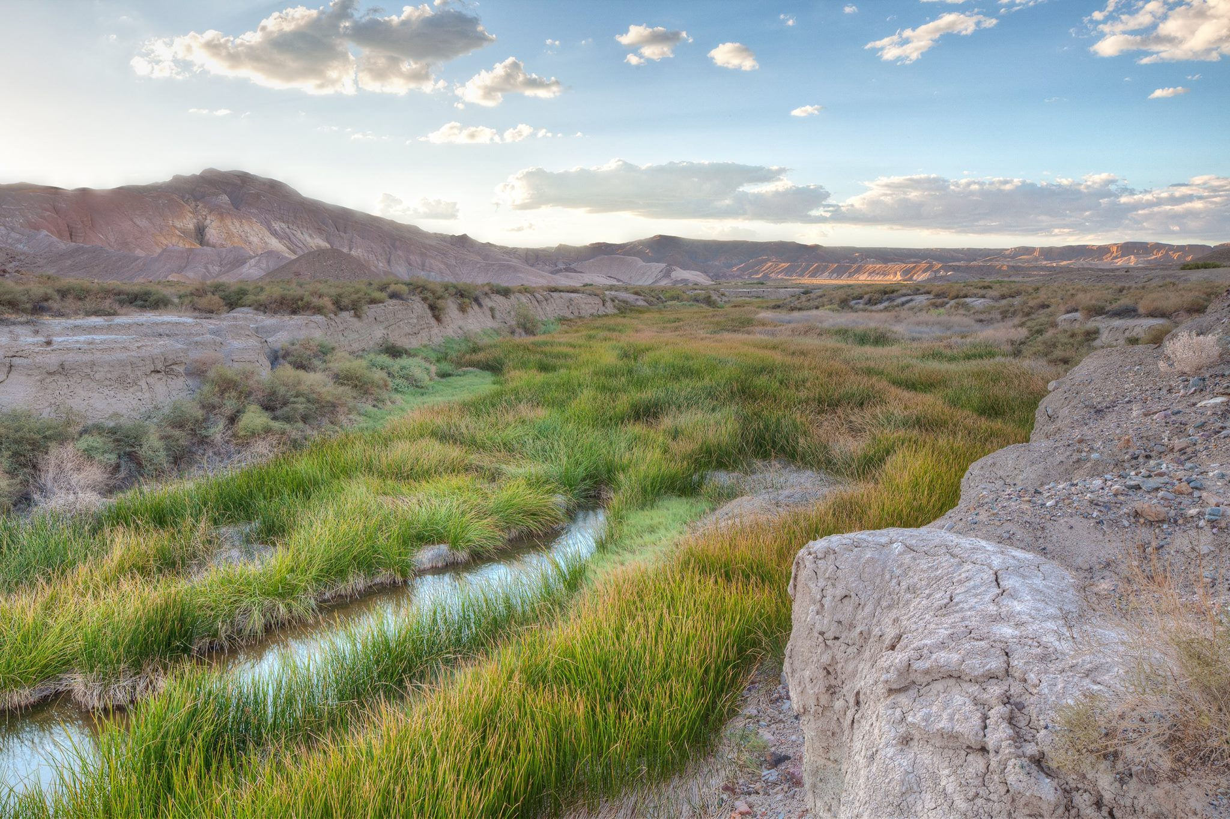
Thank you!
Amargosa River, Mojave Desert

Slide 7
Shasta Valley spring-fed stream, Northern California

Slide 8
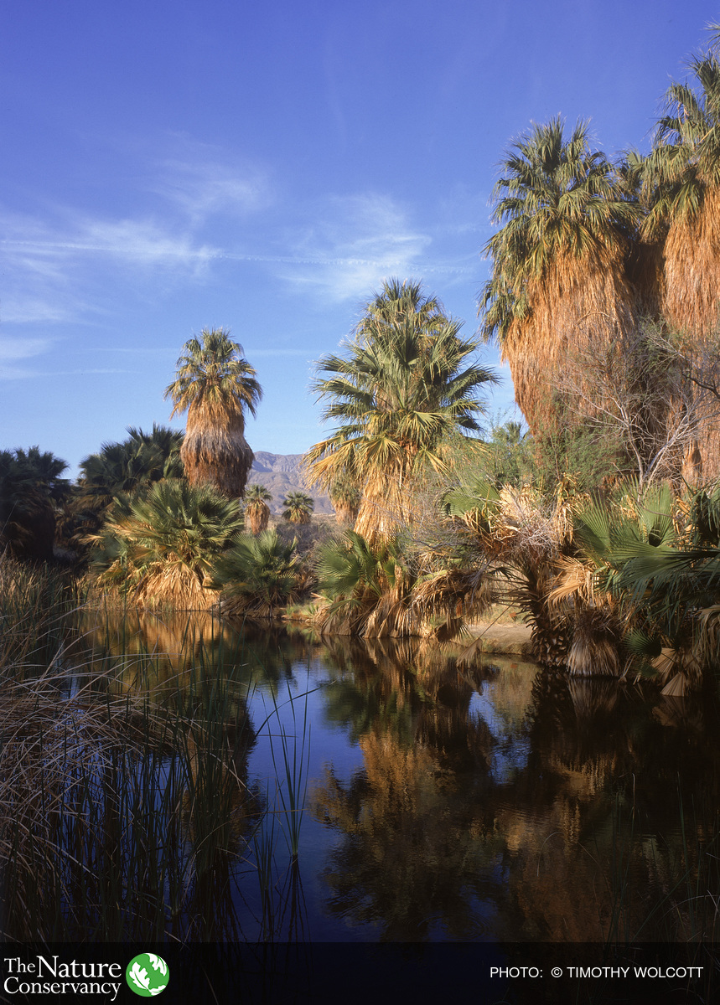
Desert Palm Oasis, Coachella Valley, Southern California

Slide 9
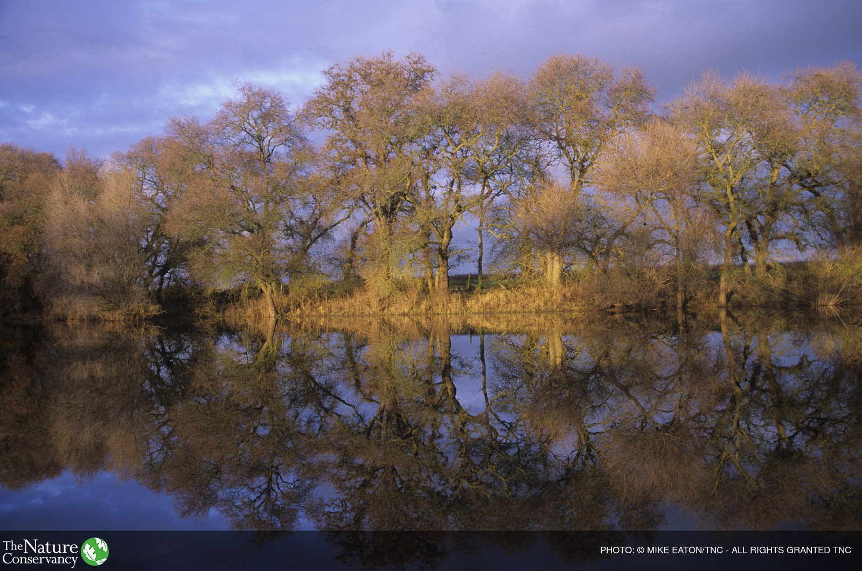
Cosumnes River, Central Valley

Slide 10
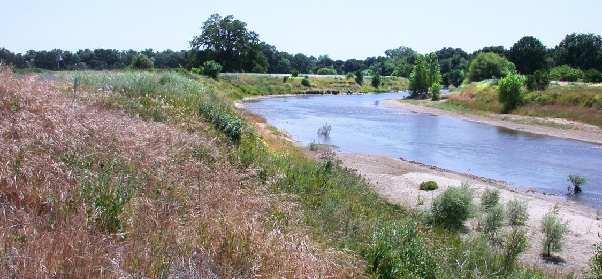

Slide 11
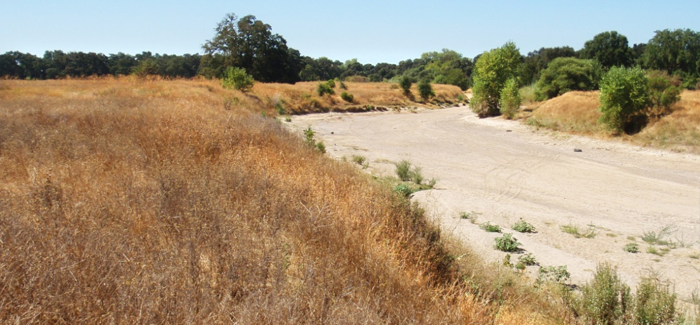

Slide 12
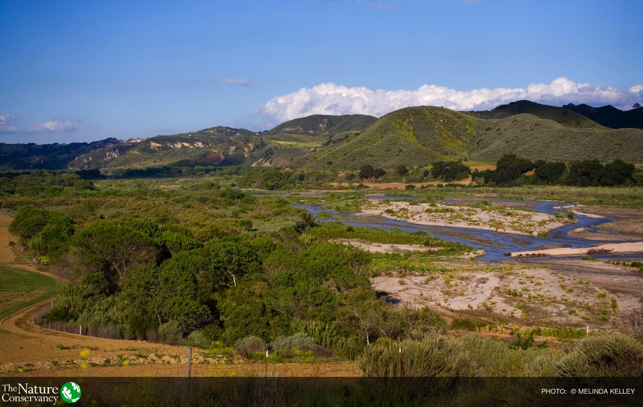
Santa Clara River, Ventura County
Notes:
On the SCR, one of the big GDE’s is the riparian habitat found along the river
These are areas where vegetation remains green year-round, largely due to high gw levels
GW is not only important to GDEs – also important to ppl. In a normal year, 38%... 60%
15 sec (2 min 15 sec)

Slide 13
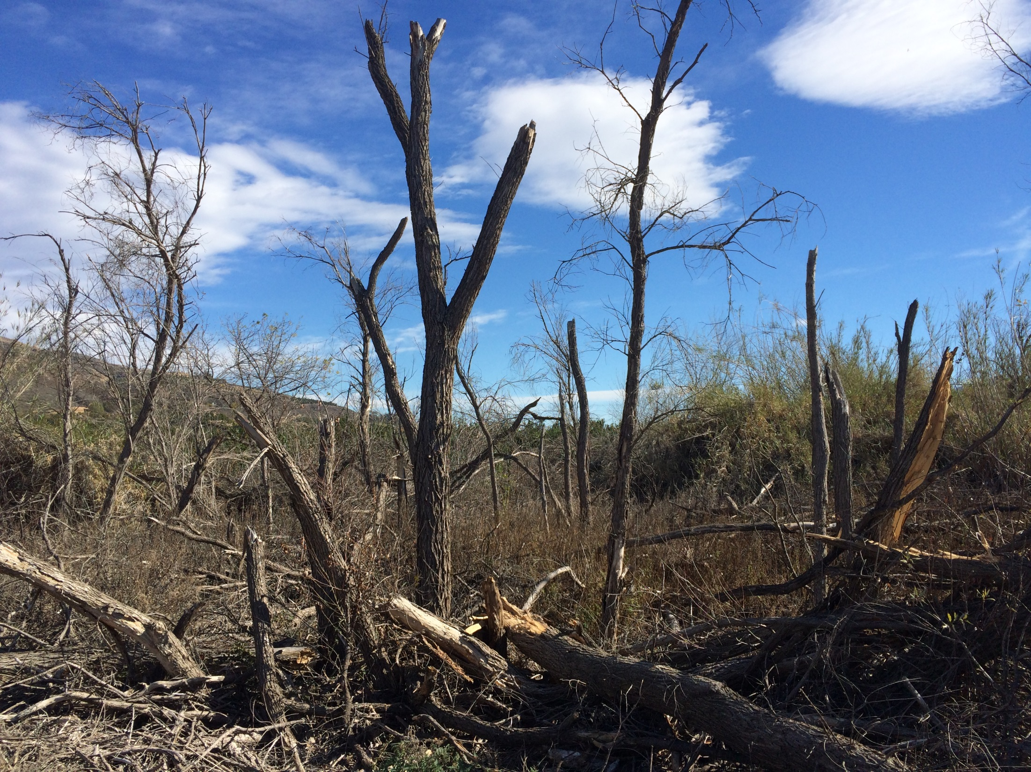
Notes:
This is a property TNC owns on the SCR – an area we bought b/c of the year0round habitat
Last summer, we discovered the trees and willows had died. When we investigated, we saw a significant drop in gw levels
This is what happens w/ gw changes too fast or too much for GDEs
And when you have 18 T&E spp, impacts can be irreversible
(15 sec, 2.5 min)

Slide 14
SGMA:
Addressing Nature is Required
CALIFORNIA WATER | GROUNDWATER

Slide 15
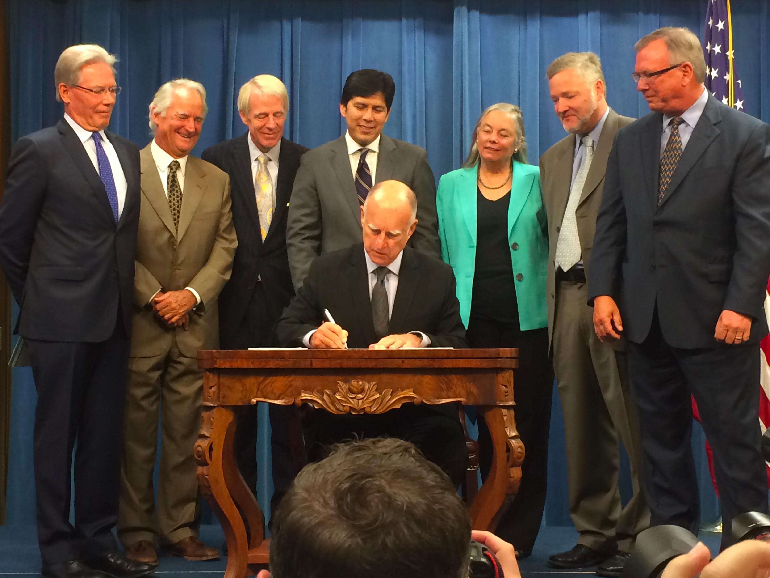
CALIFORNIA WATER | GROUNDWATER

Slide 16
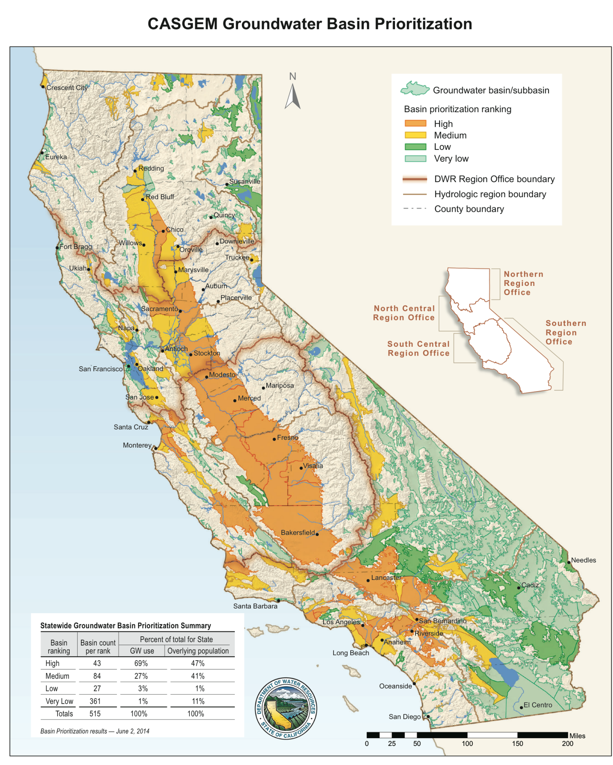
Regulated
Not regulated
Notes:
Current Criteria for Rankings:
Population
Population growth
Public supply wells
Total wells
Irrigated acreage
Reliance on groundwater as primary source
Impacts on the groundwater (overdraft, subsidence, saline intrusion, quality)
Other information, per DWR
And Coming Soon…
9. “adverse impacts on local habitat and local streamflows” (Water Code §10933(b)(8))

Slide 17
SGMA: Examples of Provisions for Nature
Map land uses, including native vegetation (23 CCR §354.8(a)(4))
Describe beneficial uses and users of groundwater in the basin, including nature (23 CCR §354.10(a))
Develop a hydrogeologic conceptual model that includes seeps, springs, wetlands and surface water bodies (23 CCR §354.14(d)(4-5))
Describe current and historical groundwater conditions, including interconnected surface waters and groundwater dependent ecosystems (23 CCR §354.16(f-g))
A water budget that quantifies water use, including for managed wetlands and native vegetation (23 CCR §354.18(b)(3))
CALIFORNIA WATER | GROUNDWATER

Slide 18
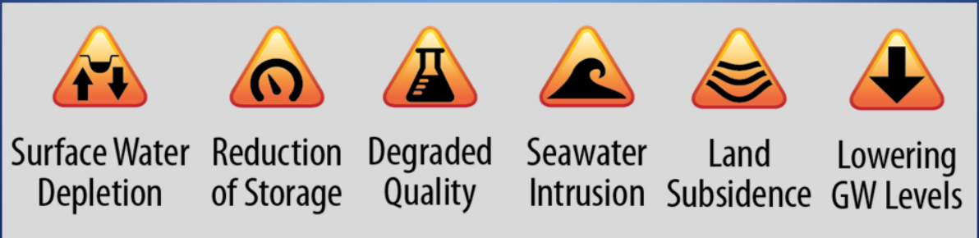
SUSTAINABILITY
The absence of…
“Significant and unreasonable”
Graphic by: Department of Water Resources
CALIFORNIA WATER | GROUNDWATER

Slide 19
Beneficial Uses
  Rare, Threatened or
  Endangered Species
“Uses of water that support habitats necessary, at least in part, for the survival and successful maintenance of plant or animal species established under State or federal law as rare, threatened or endangered”
- DWR, Bulletin 118

Slide 20
SGMA Timeline
Jan 31, 2020
Jan 31, 2022
GSPs for basins in critical overdraft due
GSPs for all other basins due
June 30, 2017
GSAs file with DWR
Jan 1, 2017
Alternatives to GSPs due to DWR
June 30, 2017
Jan 31, 2020
Jan 31, 2022
Board may hold a hearing to designate a basin as a “probationary” if no GSA
Board may hold a hearing to designate critically-overdrafted basin as “probationary” if GSP is inadequate
Board may hold a hearing to designate med and high basins as “probationary” if GSP is inadequate
Jan 1, 2017
DWR publishes BMPs
2017
2018
2019
2020
2021
2022
2040/2042
Winter 2017-18
2040/42
DWR updates Basin Prioritization, and reissues (as needed) basins subject to critical conditions of overdraft.
Jan 1 – Mar 31, 2018
~Aug 2018
Basins achieve sustainability
Basin boundary modification requests due
Final basin boundary modifications released
CALIFORNIA WATER | GROUNDWATER

Slide 21
Get Active!
Tools & Resources
CALIFORNIA WATER | GROUNDWATER

Slide 22
Take Action!
  Provide maps and data to your local GSA on conservation lands and values
  Access tools on GDEs at groundwaterresourcehub.org – available this spring
  Join the NGO Groundwater Collaborative (contact: jclary@cleanwater.org)
  Assess groundwater use and recharge provided by your conservation lands – ensure these are included in the GSP
  Advocate for conservation lands as a beneficial use in the GSP
  Work with your local GSA to develop groundwater replenishment projects that advance conservation
  Advocate for inclusion of, and serve as, an environmental representative on your local GSA
CALIFORNIA WATER | GROUNDWATER

Slide 23
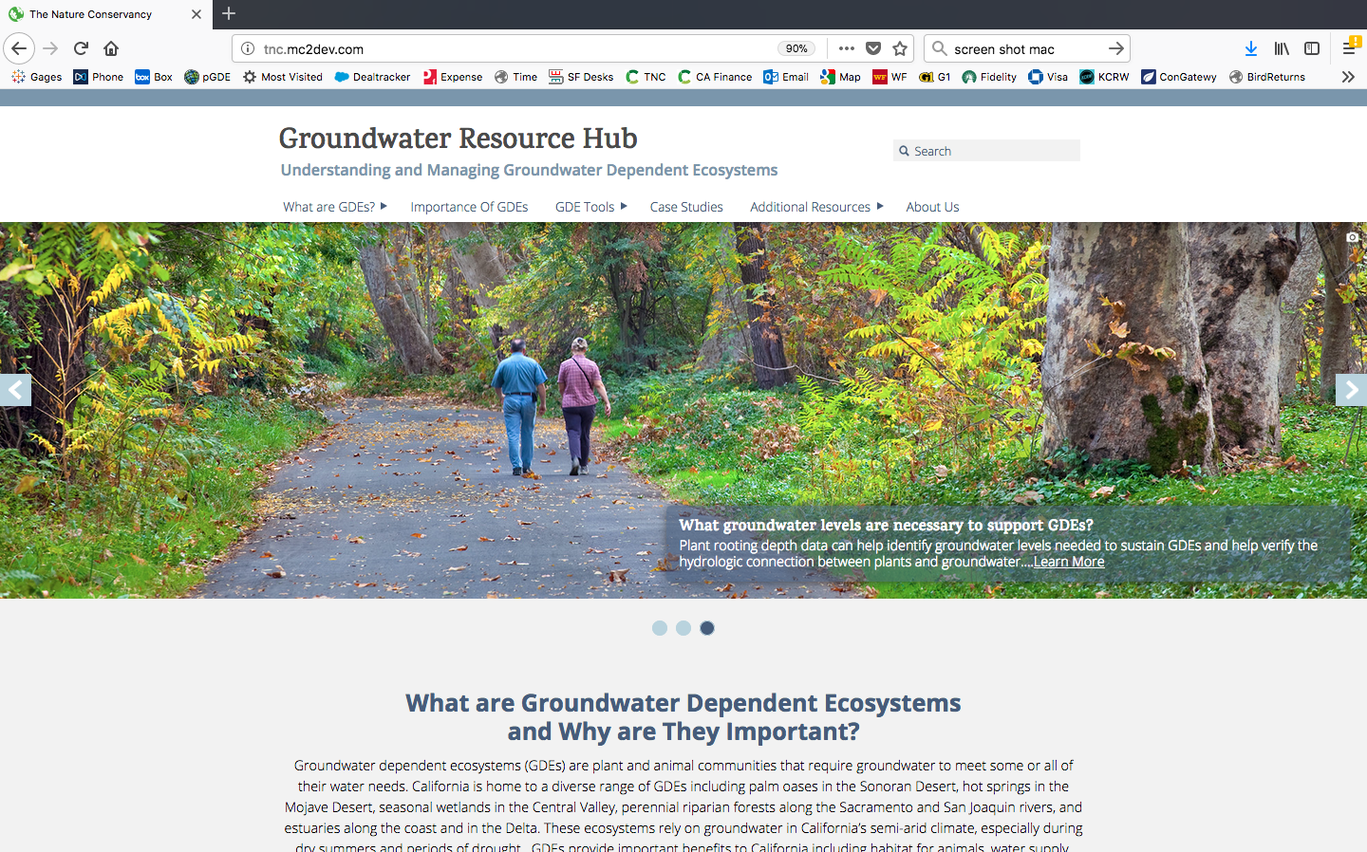
Online Resource| Launching Spring 2018
Groundwaterresourcehub.org

Slide 24
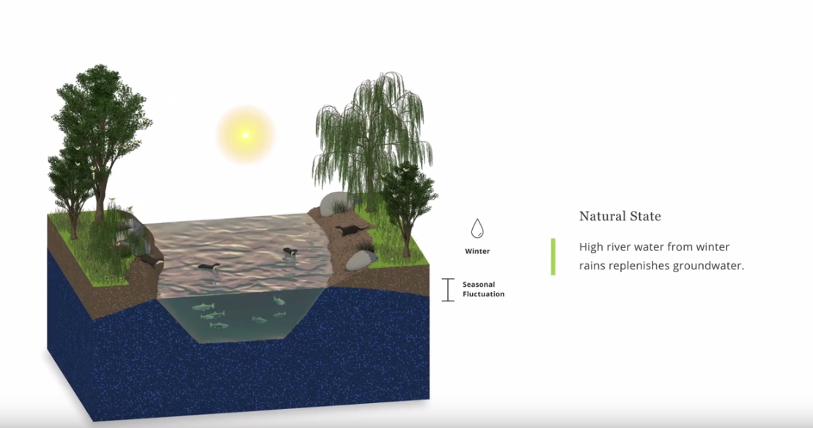
What are GDEs? | Online Tutorial

Slide 25
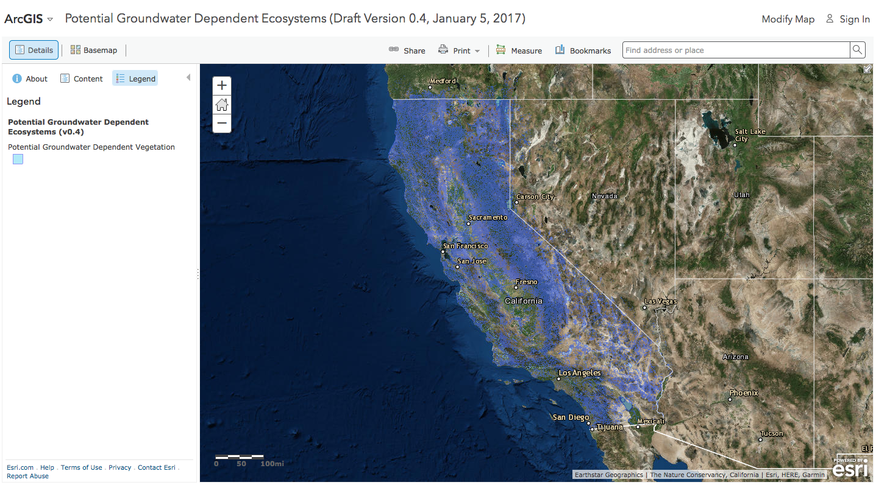
Where are GDEs?| iGDE Database

Slide 26
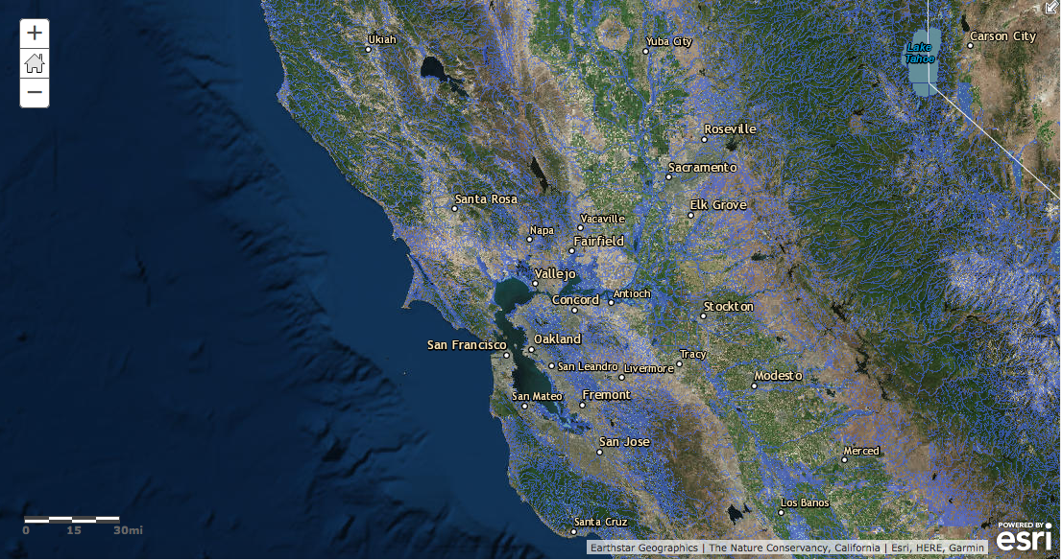
iGDE Database | Informing Local Decisions

Slide 27
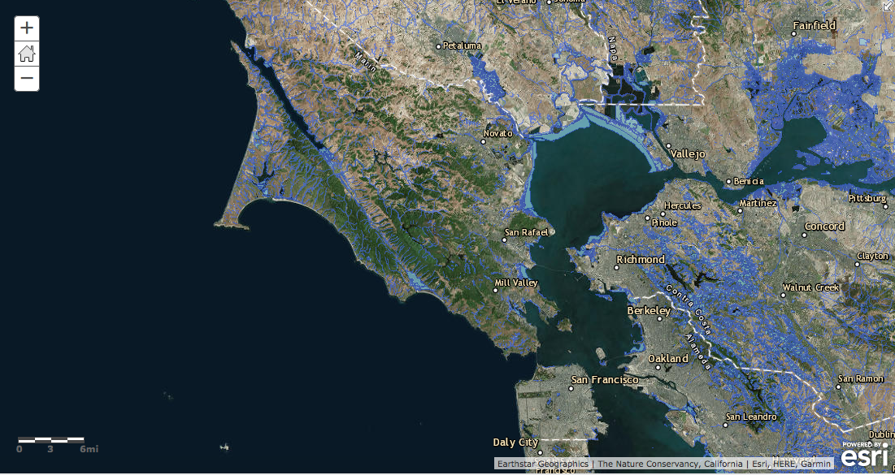
iGDE Database | Informing Local Decisions

Slide 28
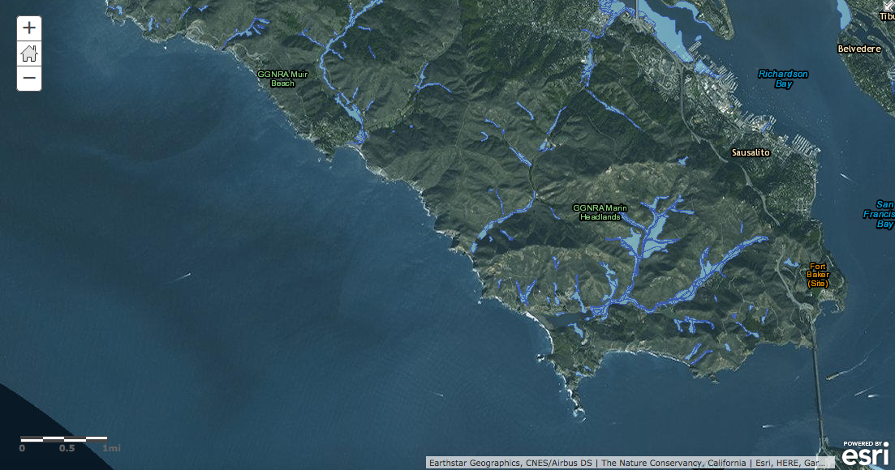
iGDE Database | Informing Local Decisions

Slide 29
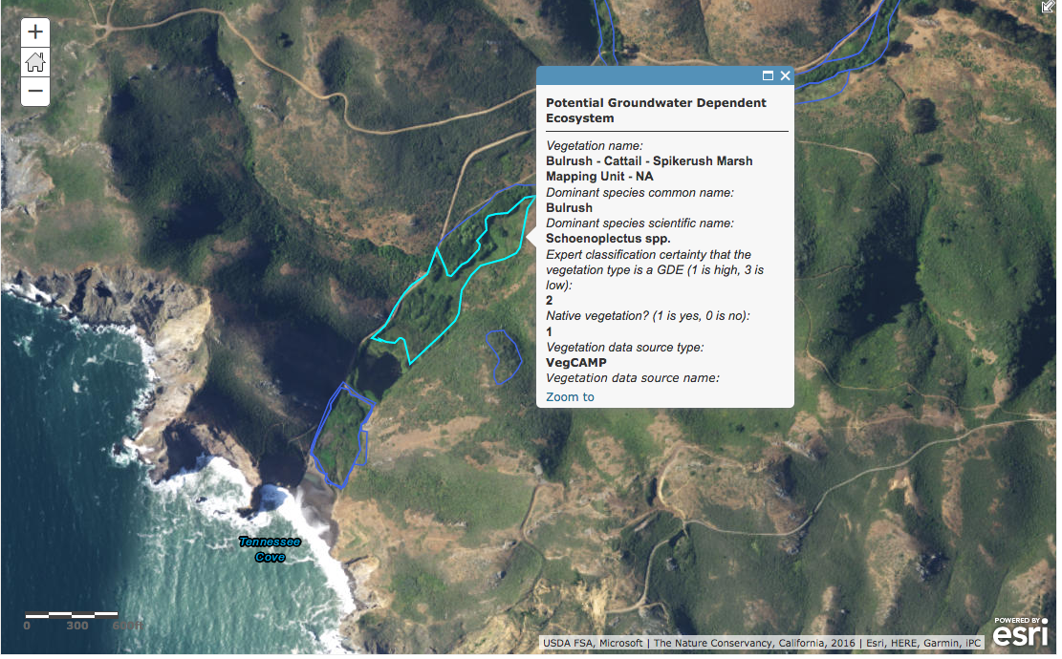
iGDE Database | Informing Local Decisions

Slide 30
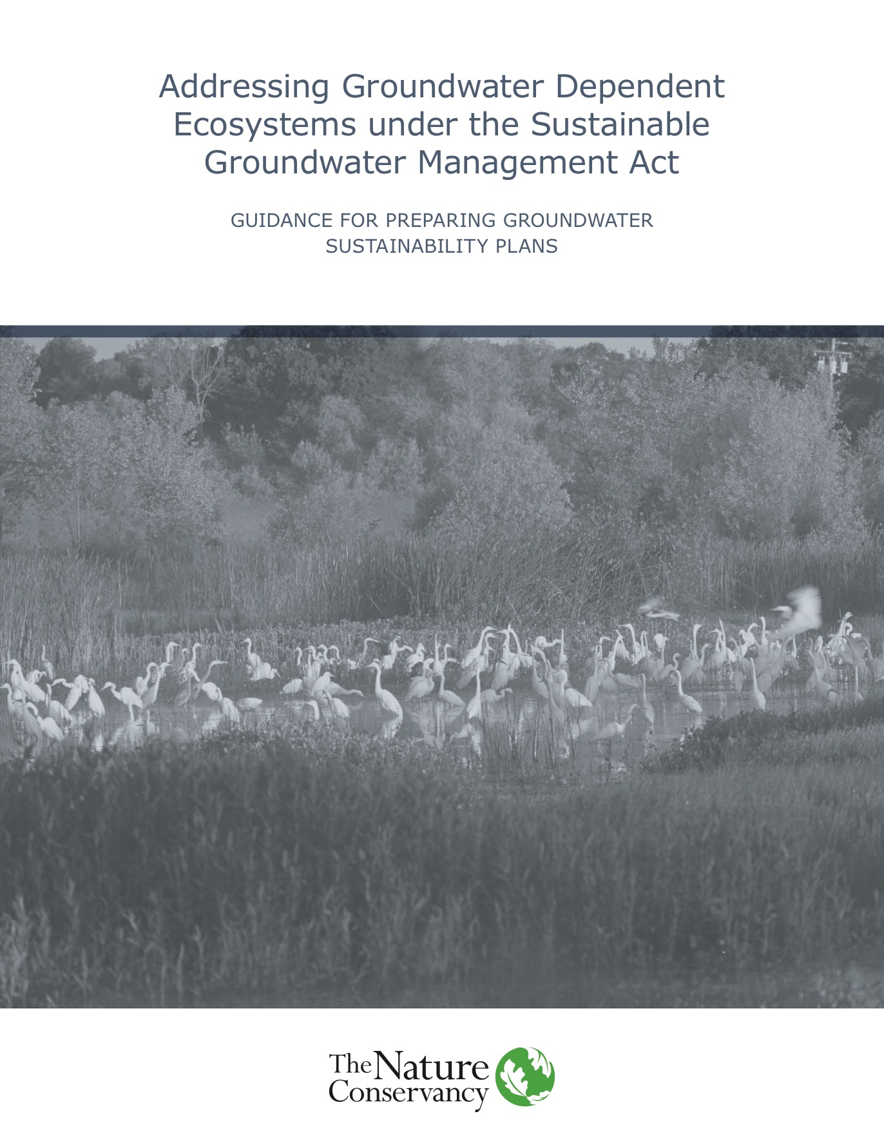
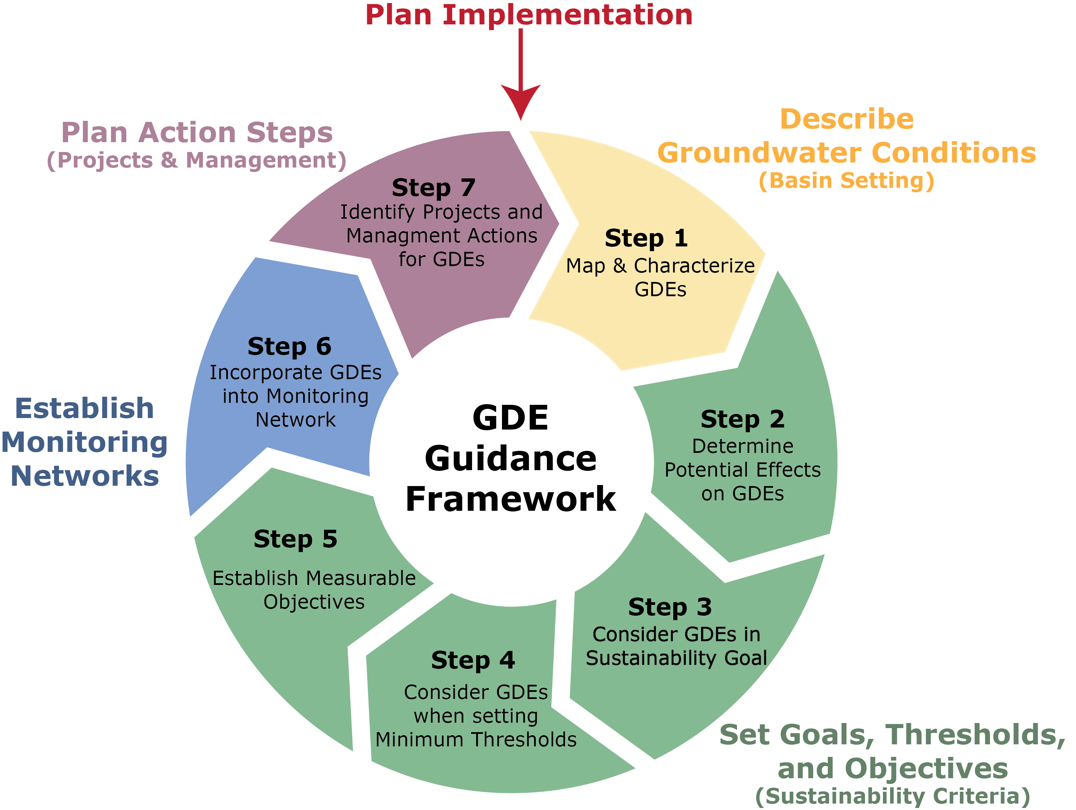
How To| Addressing GDEs in GSPs

Slide 31
Take Action!
  Provide maps and data to your local GSA on conservation lands and values
  Access tools on GDEs at groundwaterresourcehub.org – available this spring
  Join the NGO Groundwater Collaborative (contact: jclary@cleanwater.org)
  Assess groundwater use and recharge provided by your conservation lands – ensure these are included in the GSP
  Advocate for conservation lands as a beneficial use in the GSP
  Work with your local GSA to develop groundwater replenishment projects that advance conservation
  Advocate for inclusion of, and serve as, an environmental representative on your local GSA
CALIFORNIA WATER | GROUNDWATER

Slide 32
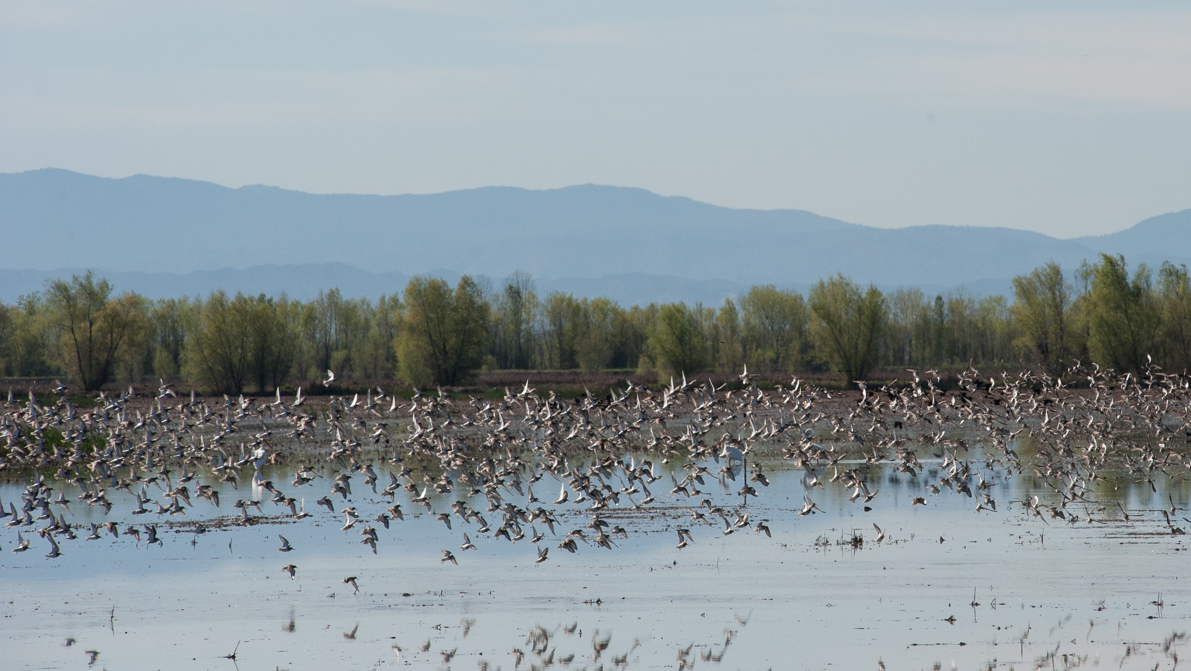
THANK YOU
SANDI MATSUMOTO
smatsumoto@tnc.org

